Slide 1

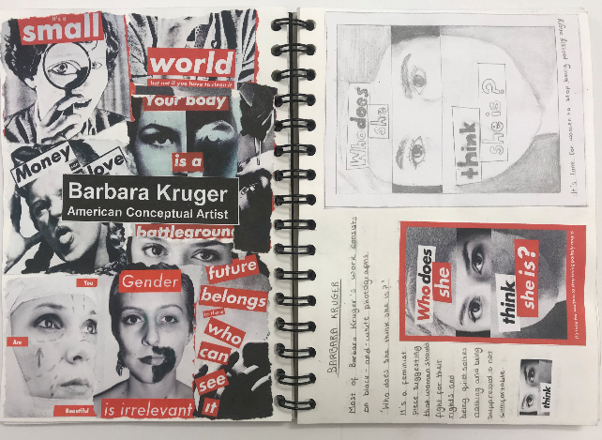
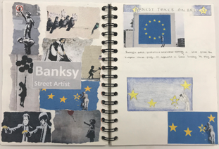
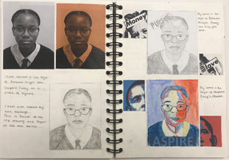
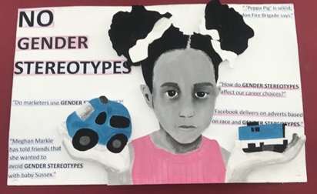
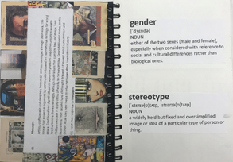
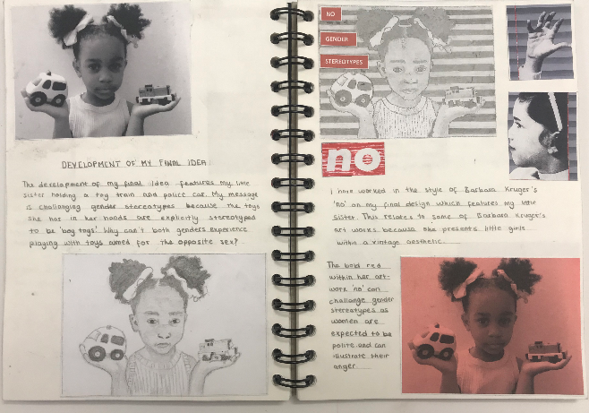


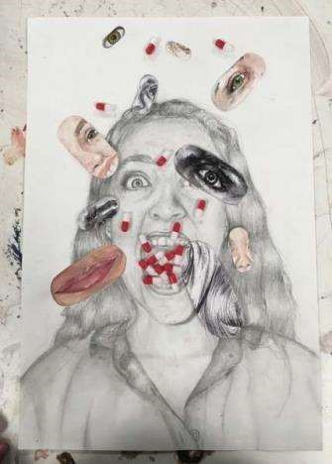
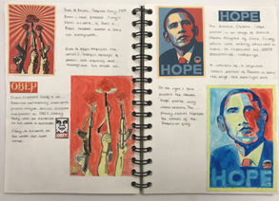
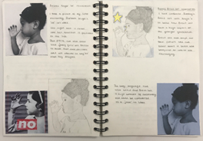
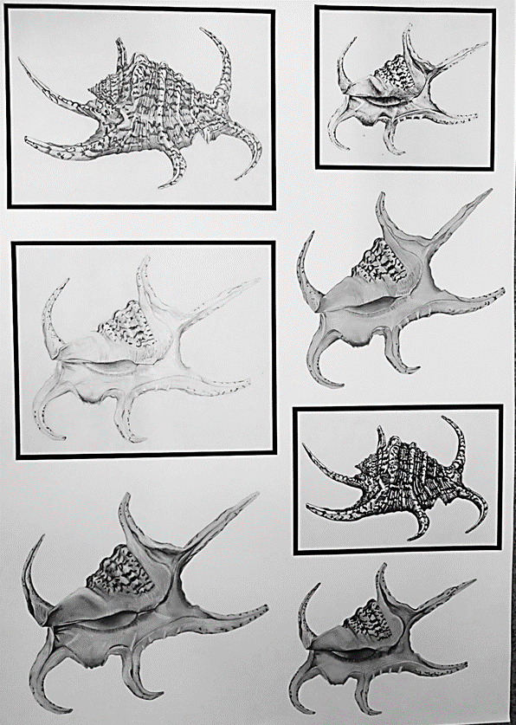
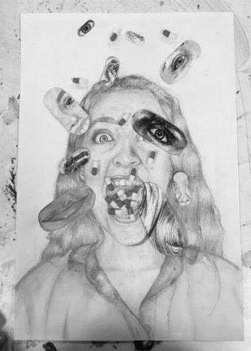
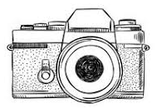
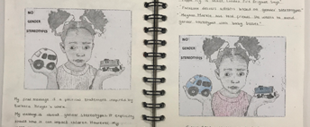
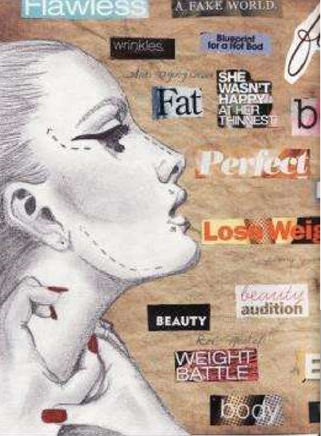
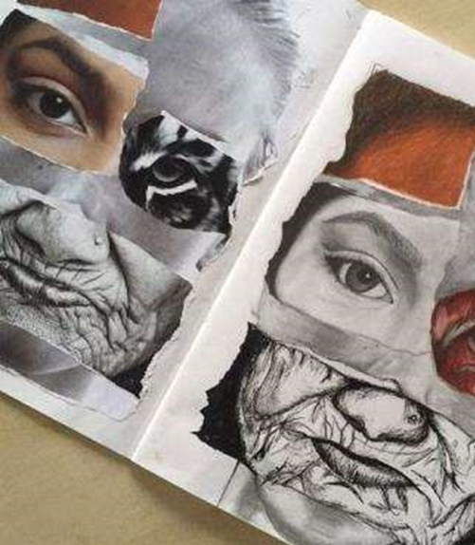
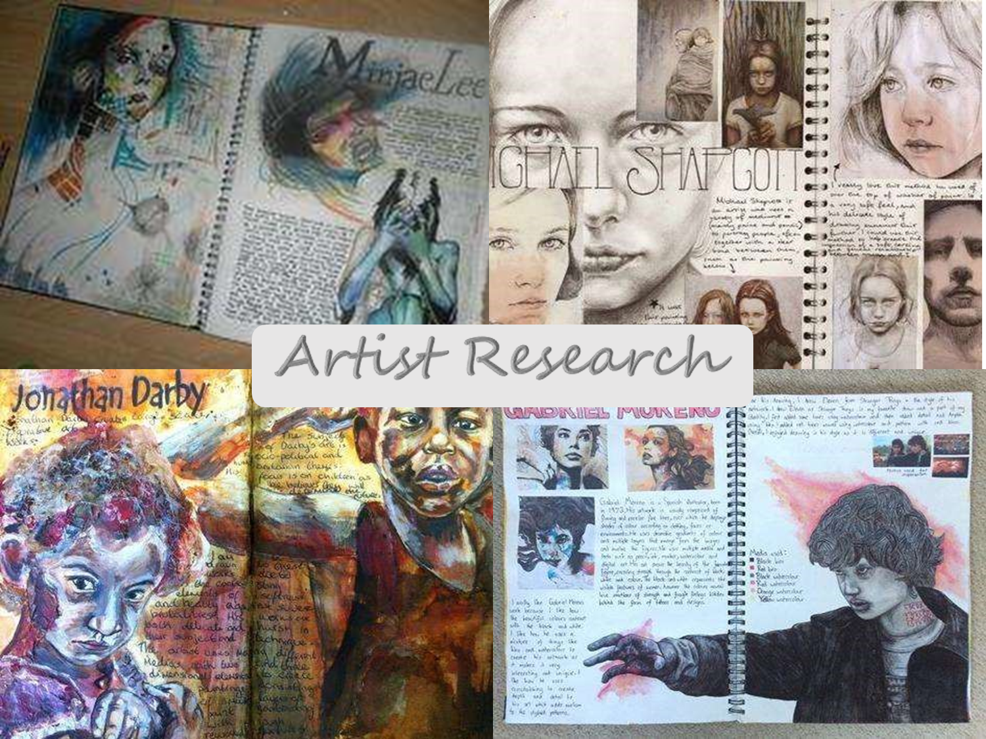
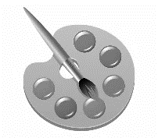


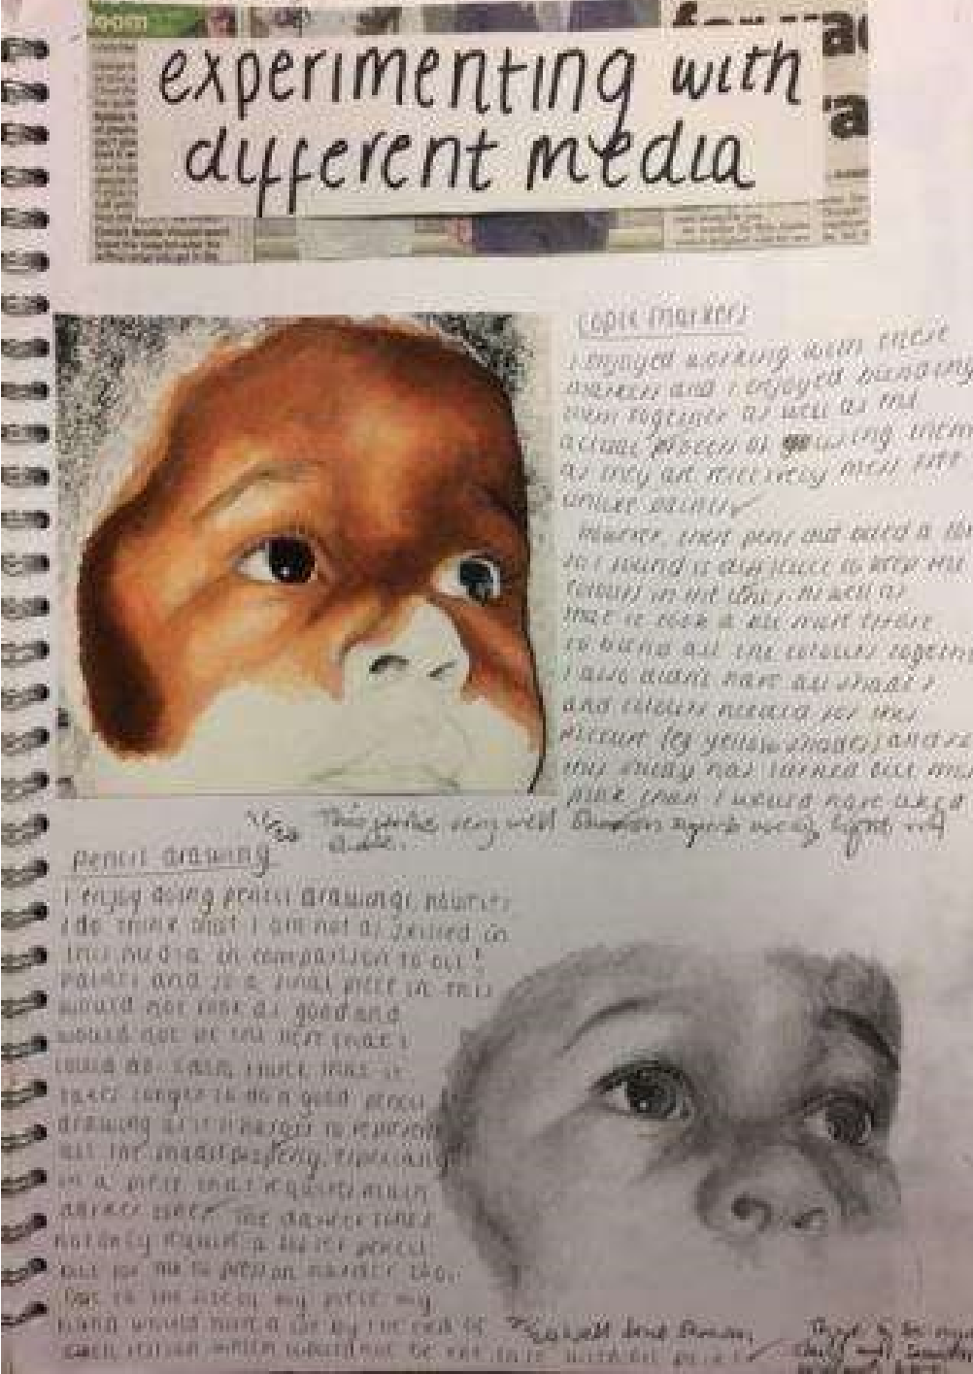
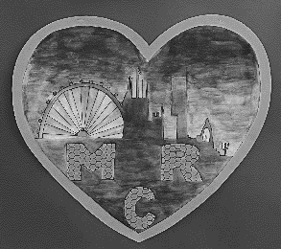
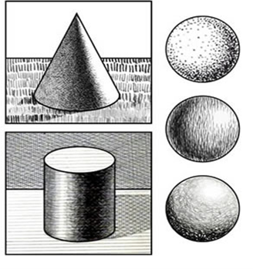
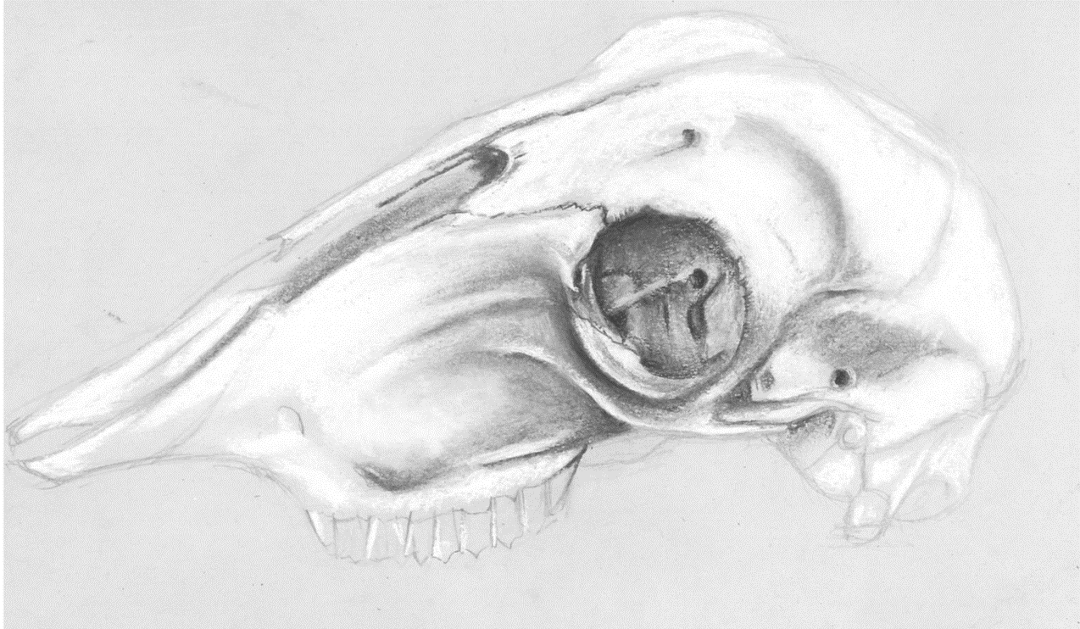
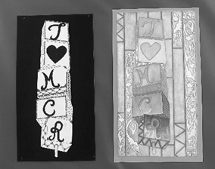

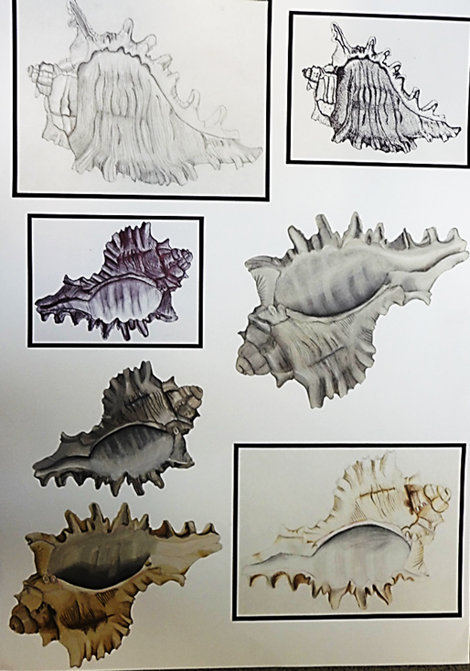
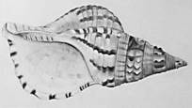
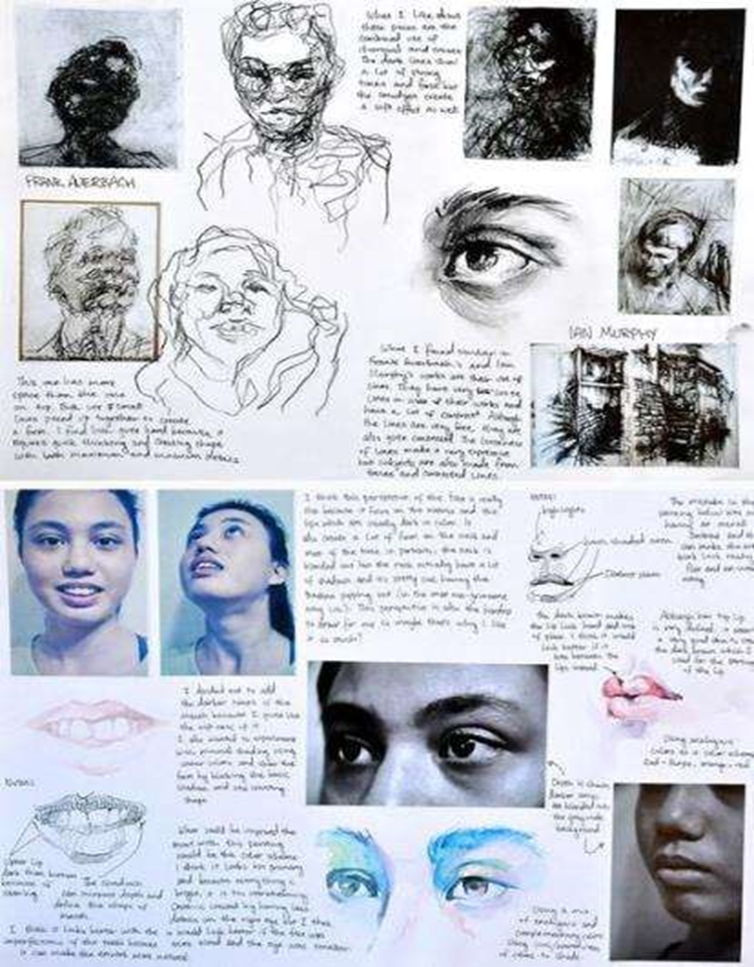

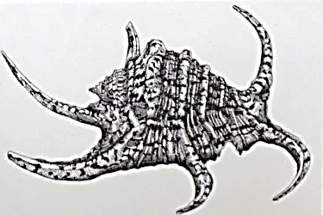
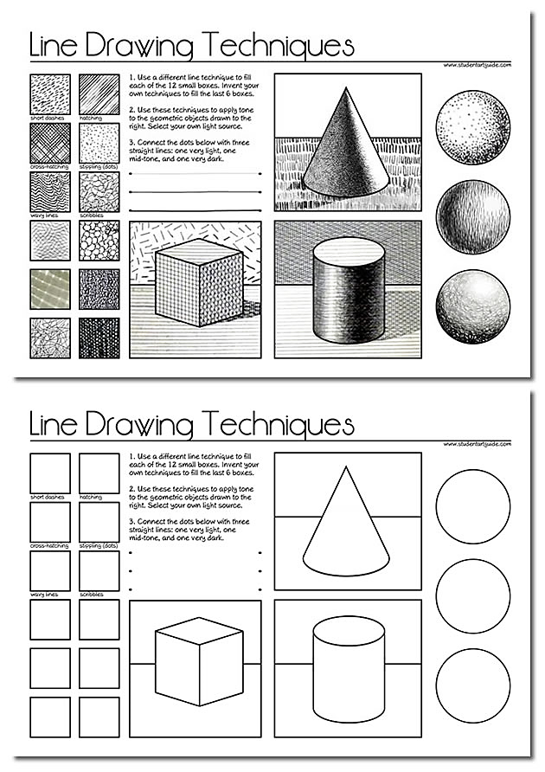
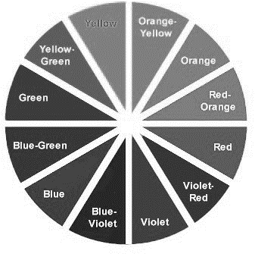
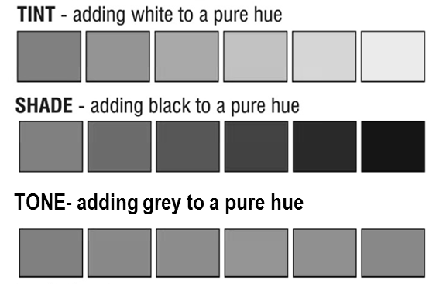
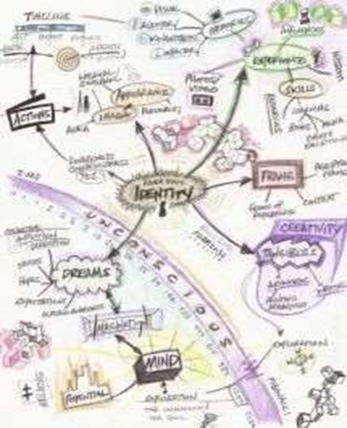
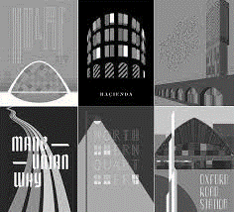
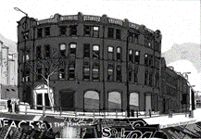
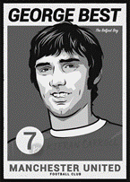
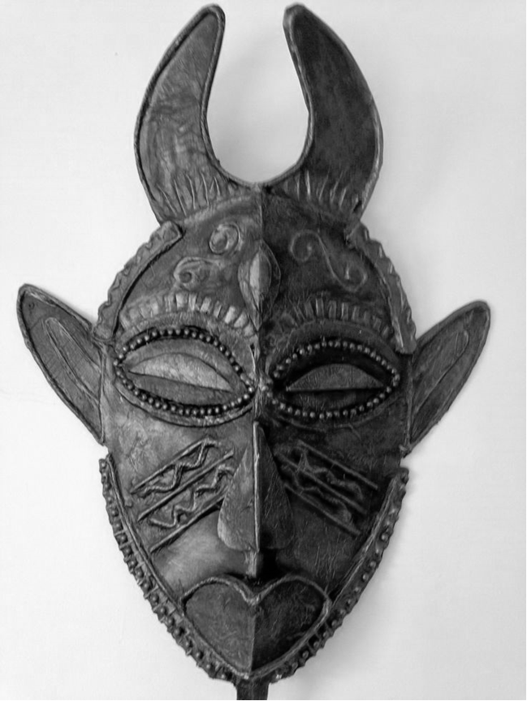
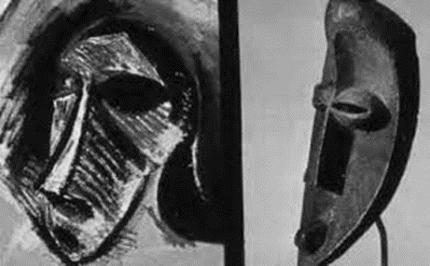
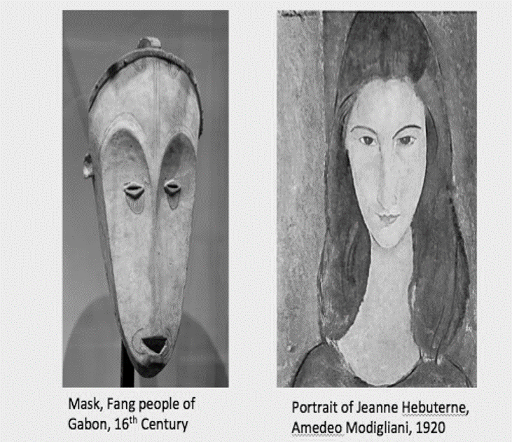
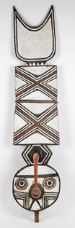

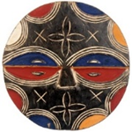

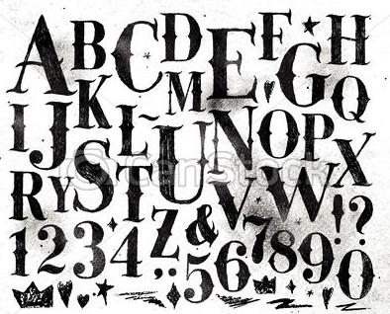

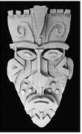
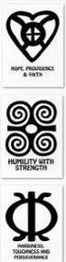
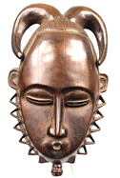
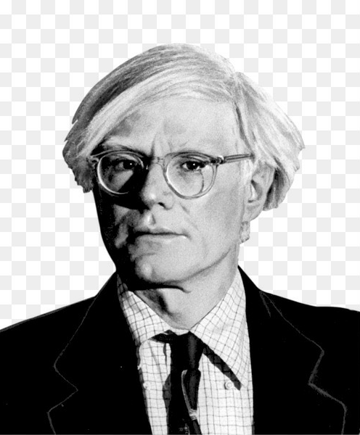

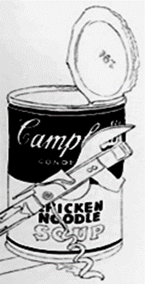
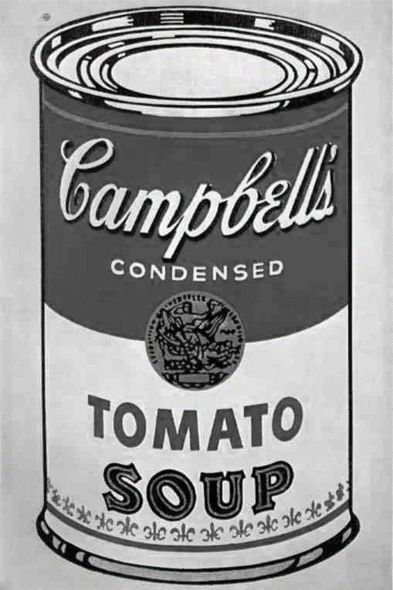
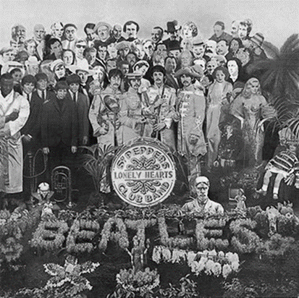
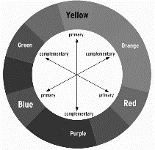
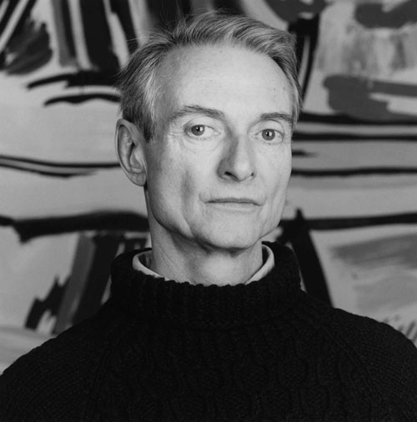
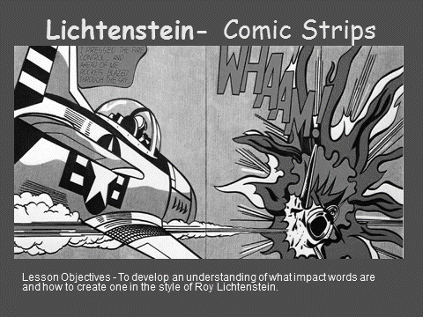
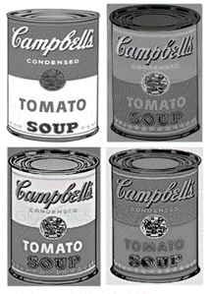



























Art and Design Learning Journey
Year 7
Understanding and Applying Skills
Year 11
Develop an understanding of the Formal Elements of Art
Develop knowledge and understanding of artists work
Develop skills in use of media and techniques- 2D and 3D construction
Develop an understanding of the design process
Ability to record relevant ideas and observations as work progresses
Ability to develop ideas through investigations informed by contextual and other sources
Ability to refine ideas selecting appropriate media and techniques
Develop skills in measuring understanding of proportion and symmetry
Develop drawing skills using formal elements
Develop knowledge and understanding of Colour theory
Demonstrate knowledge, skills and understanding of the Formal Elements of Art
Demonstrate skills in use of media and techniques- 2D and 3D construction
Demonstrate analytical and cultural understanding
Ability to realise intentions and create a personal and meaning response
showing understanding of visual language
Include chosen starting point at the front of sketchbook
Research artists from the exam paper find images and information relating to chosen starting point
Further research other artists/ideas relating to chosen starting point
Design development-set of design ideas annotated
10 hour Exam- Final piece- Personal response
Completion of C1 Portfolio of work
GCSE exam paper issued in January- select 1 starting point
C2 Externally Set Assignment- Preparatory work
C2 ESA- Exam
C1 Portfolio completion
Exam & Post – 16
Destination
Relief sections raised on blocks
Find dictionary meaning/mind map starting point
Complete drawings/studies and annotations from research
Development of own ideas - drawings/photographs/other resources relating to chosen starting point
Final design- and colour studies annotated
Written explanation of final design
Inclusion of text/ photographs/ symbols to complete personal response
ABC
C1 Identity Project
Development of own ideas - drawings/photographs/other resources relating to chosen starting point
Application of paint from final design colour study
Final design- and colour studies annotated
Research of relevant artists and their work on the theme of identity/ portraits
YEAR
C1 Identity Project
11
C1 Identify Project Final Piece
C1 Identity Project Design Development
Assembling composition- card relief construction
Enlarged final design to scale. Scale is a design element which relates to size.
Design development-set of design ideas annotated
Use of a range of media and techniques
C1 Identity Project
Addition of surface decoration
The Formal Elements of Art- Observational drawing
Contour Line- use of line to define an edge
Media and techniques- Charcoal and chalk/ paint
Media and techniques- Colour pencil, paint
The Formal Elements of Art- Observational drawing of self portrait
Shape- Geometric and organic
Colour mixing and blending
Final piece- mixed media
YEAR
Scale
Proportion
Tone-Highlight, shadow, contrast, form, depth
C1 Identity Project
Drawings from photographs
Final design enlargement
2D Final Design
10
C1 Natural Forms
C1 Natural Forms
Final design- and colour studies annotated
Written explanation of final design
Texture- Visual and actual
Tone /Value- tonal scale
Colour Theory-
Colour value – tints, shades and tones.
Exploration of ideas on identity- sketchbook wok
Refinement of successful designs,
Design Development
Stanley Chow
Caroline Johnson
Media and techniques- Pencil and pen drawings
Mark making
Pattern- regular and irregular
Symmetrical African mask designs from study
Kieran Carroll
Addition of surface decoration- string.
Refinement and
application of paint
Pablo Picasso
Inspired by African Dan masks
Amedeo Modigliani Inspired by African Fang masks
Reflection Symmetry- line symmetry or mirror symmetry
Study of Tribal African Masks- worn for protection, concealment or performance
Design ideas developed from research studies- images and text
Research of graphic artists and annotated studies from chosen starting point.
African Mask Design Development
Graphics- I Love Manchester
African 3D Design
African 3D Design
Historical, modern and contemporary typography
I Love Manchester Design brief inspired by Milton Glaser designer of the I heart NY logo,1976
Skills development- Trace and transfer onto card-
card construction
Final design development
Adinkra symbols-
Used by the Akan and the Asante tribes of West Africa
Research studies and annotations.
What is Pop Art? - an art movement that emerged in the United Kingdom and the United States during the 1950s.
African Colour Symbolism
YEAR
Beatles – Sgt Pepper’s Lonely Hearts Club Band 1967
9
YEAR
Andy Warhol
1928 –1987
Campbell’s soup cans
Peter Blake
Jan Harworth
Colour Theory- Complementary colours
Roy Lichtenstein
1923-1997
Comic book style
Self Evaluation
8
Pop Art- Warhol
Pop Art- Lichtenstein
Self Evaluation
Baseline- can drawing
Drawing from secondary sources. Elements of Art; - line, shape, form
Skills in media; pencil, crayon and paint. Colour mixing
Onomatopoeia. Impact words
Design development- Elements of Art- Line, shape, pattern, colour
Ben Day dots
The Ben Day process named after illustrator and printer
Enlarged card relief piece- skills development-application of media
Skills development- 3D modelling-
Measuring, guidelines. Symmetry
Repeated Can- Elements of Art; tone, colour
Leonardo
Da Vinci
Anatomical studies
Gargoyles
Gargoyle designs
Skills development- application of media; pastel/crayon and paint. Colour mixing
Edvard Munch
Expressionism
The Scream (1893)
Colour Theory-primary, secondary, tertiary
Proportions of the Face
Frida Kahlo and Sonia Boyce-
symbolism, cultural background
Measuring, drawing guidelines. Symmetry
Contemporary artists; Anthony Gormley- Field, Another place
Sophie Cave- Heads
YEAR
Expressive Composition
Self Portrait
7
Gothic Architecture- Grotesques and Gargoyles
Colour symbolism- Warm and Cold colours
Eyes- detail
The Formal Elements of Art
Baseline Assessment- Self portrait
Colour Theory- Colour schemes- monochromatic, complementary/ contrasting colours
Perspective
Pablo Picasso Self-Portrait in Blue Period (1901)
Skills development-application of tone and colour
Observational drawing- Self Portrait

