Slide 1
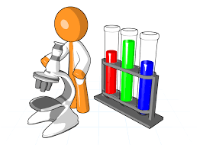
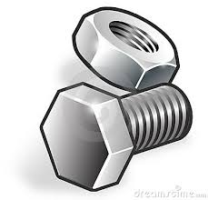
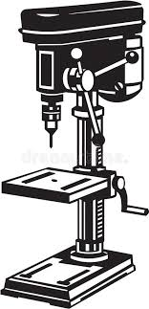
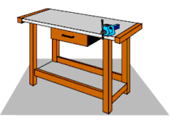
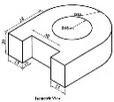
Engineering
KS4 Learning Journey
Year 10
Understanding and Applying Engineering Skills
Year 11
Work safely and responsibility in workshop
Apply quality control measures
Evaluate quality of work/ outcome
Independently demonstrate safe use of machinery
Independently setup CAD CAM equipment
Evaluate pre production item against specification
Evaluate types of waste
Apply principles of sustainable design
Interpret engineering drawings
Assess risk
Conform to drawing conventions
Select appropriate material testing method
Apply safety measures when using machines and hand tools
Plan for manufacture
Select and use appropriate PPE
Know materials, properties and engineering uses
Understand modern manufacturing methods
Learning Outcome 3: Know how modern technologies can be used in quality control
applications of modern technologies
Causes of waste in manufacturing
Design for Manufacturing Assembly
Non-destructive testing
Methods of reducing waste
Common fixing strategy
Complexity reduction
Exam & Post – 16
Destination
Term 3
R014 Exam Preparation
Know the principles of lean manufacturing
Categories of waste (7 lean wastes – TIMWOOD)
Standardised components
Sustainable design
Assess product quality from inspection and quality control techniques
Reasons for implementing quality control in production
The importance of quality control
Impact of modern technologies on engineering production
Additive manufacturing
Computer Numerical Control (CNC) machining processes
Safe use of tools and equipment
Laser applications
Machine processes
Techniques for evaluating product
Term 2
Surface finishing
Use of inspection equipment
Heat treatment
Application of basic inspection checks
Quality control techniques used in stages of production
Quality procedures
Automation
Global manufacturing
Developments in engineering processes
Moulding
Digital communications
Material removal
Be able to set-up and use CNC equipment to manufacture components
Methods used to compare items manufactured by manually controlled and CNC production
Standardisation of processes and procedures
Understand engineering processes and their application
Factors to consider when performing CNC machine programming operations
Know about applications of computer control processes used in manufacture
Forming
YEAR
Joining methods
Term 3
11
Term 1
Hand forming
Procedures for setting up CNC equipment
Speeds and feeds for the size and type of materials
Interpret information from (CAD) to manufacture Components on CNC equipment.
Rapid prototyping
CNC machining - additive manufacturing
Computer controlled processes used for different scales of manufacture
Material removal
Use of Computer Aided Design (CAD) packages
Robotics
Basic engineering processes
Scale of manufacture
Be able to plan the production of components on Computer Numerical Control (CNC) machines
Destructive and non destructive testing
New and emerging materials
Polymers: Thermoplastics and thermosetting plastics
Types of engineering materials
R014 End of year Exam Preparation
Material Testing processes
Composites
Term 2
Unit R016: Manufacturing in Quantity
Tools required
Planning of operations
Uses of specific materials
Properties of Materials
Ceramics
Metals: Ferrous and alloys, non-ferrous and alloys
Type of machine
CNC machining operations
Characteristics of materials
Smart Materials
One-off/job production
Be able to use processes, tools and equipment safely to make a pre-production product
Bench work and hand-held tools
How to use tools and equipment when making products
Setting of machines/equipment
Personal Protective Equipment (PPE)
Consideration of scales of manufacture
Production of plans
Standard drawing conventions
Appropriate processes for making pre-production products
Manually controlled machining operations
Bench work
How to follow safe working procedures when using tools and equipment
Know about properties and uses of engineering materials
Impact of quantities of production on production plans
Compare against engineering drawings
Unit R015 Manufacturing a one-off product
Production of plans for the making
Risk Assessment
Plan for the making of a pre-production product
Use of tools and equipment.
Interpretation of 2D and 3D engineering drawings
YEAR
Term 1
10
Service • Prayer • Achieve • Respect

